Slide 1
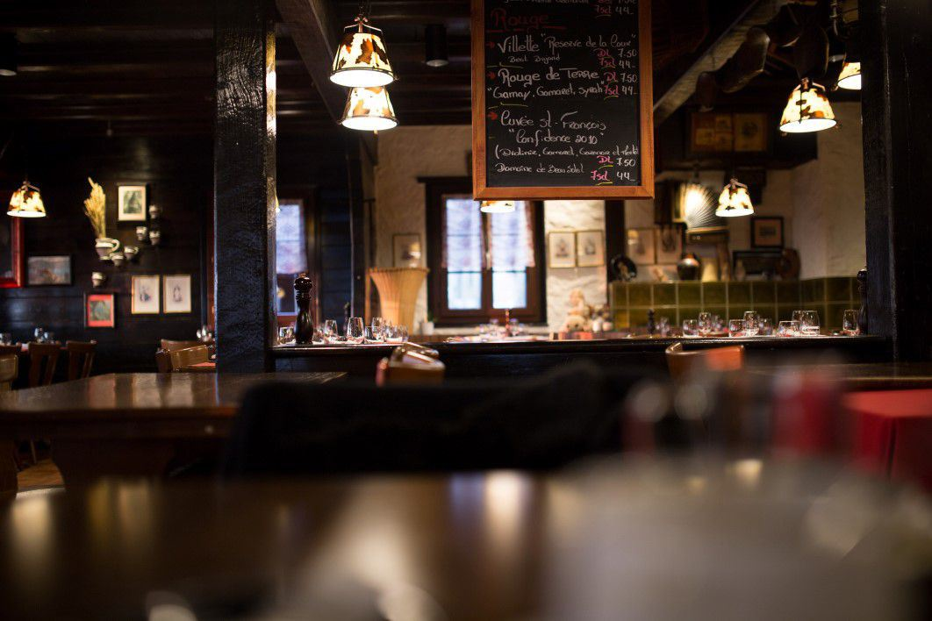
TEAM TWO CONSULTING
Mon Ami Gabi

Slide 2
TABLE OF CONTENTS
01
03
WORK ORGANIZATION & TOOLS
REVIEW ANALYSIS
02
04
KAGGLE COMPETITION
MARKETING STRATEGY & RECOMMENDATIONS

Slide 3


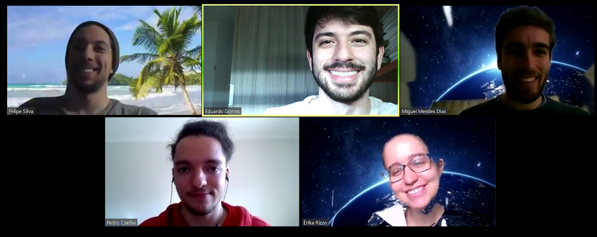







ORGANIZATION & TOOLS
Challenge: ensure that every member is in phase
72hr video call:
technical support all day long :),
align goals and deliverables
Resources and tools in cloud:
fast sharing results and progress,
working in parallel

Slide 4
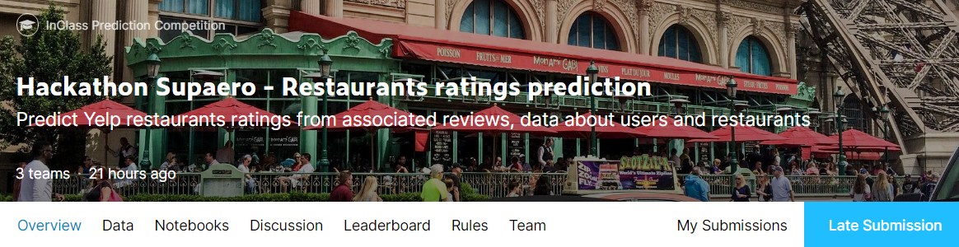
KAGGLE COMPETITION
1
2
TEXT CLEANING
NATURAL LANGUAGE PROCESSING
JOINING IT ALL TOGETHER
Lower case letters
Punctuation
Tokenization
English stop words
1-char words
Lemmatizer
TFidf scikit-learn
Ngram
Max_features
Logistic Regression
C = 10
Deploy the best sentiment analysis model
https://www.kaggle.com/c/restaurants-ratings-prediction/overview
Notes:
ERIKA
Les meilleures améliorations:
TFIDF
Cleaning
Tuning modèle de regression
Augment max_features pour le tfidf

Slide 5
KAGGLE COMPETITION
Model F1 Score: 95%
Trial & Error: improve the review based model
→ Feature Engineering
→ location note
→ user experience (second part too)
→ user popularity (second part too)
→ New architectures
What Could have been done:
→ Better data cleaning (different languages, links, ...)
→ A more rigorous tuning of parameters
→ Classification in word classes (we did for part 2)

Slide 6
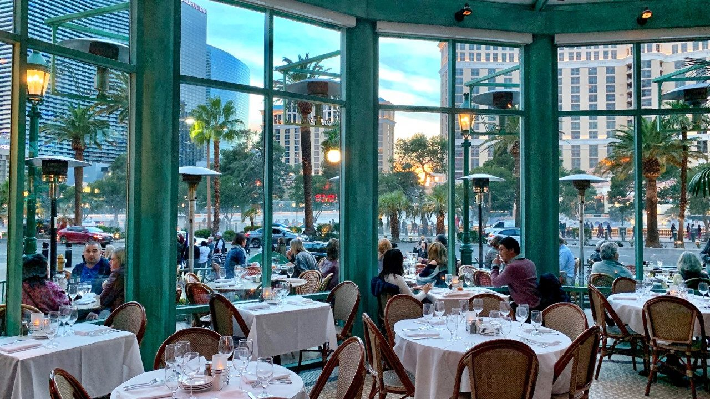
Mon Ami Gabi
Review Analysis, Marketing Strategy & Recommendations

Slide 7
OUR SOLUTION
Major players in Vegas restaurant business
Customers’ reviews evaluation
Draft a business plan strategy
MARKET ANALYSIS
CUSTOMERS ANALYSIS
BUSINESS PLAN

Slide 8
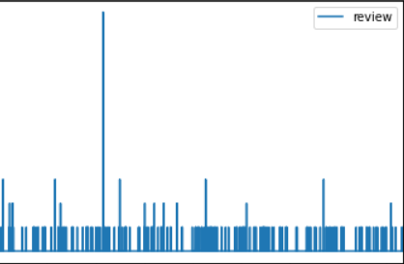
OUR
CLIENTELE
10 TIMES
8349 different customers
193 recurrent clients
414 reviews
4 TIMES
Customer

Slide 9
MAIN COMPETITORS
3 possible competitors
Sinatra
Slidin’ Thru HQh
Soho Sushi
4.167
4.29
4.43
50
40
16
96 visits
Restaurants visited by Mon Ami Gabi’s customers in similar segment (number of visits and average rating)

Slide 10
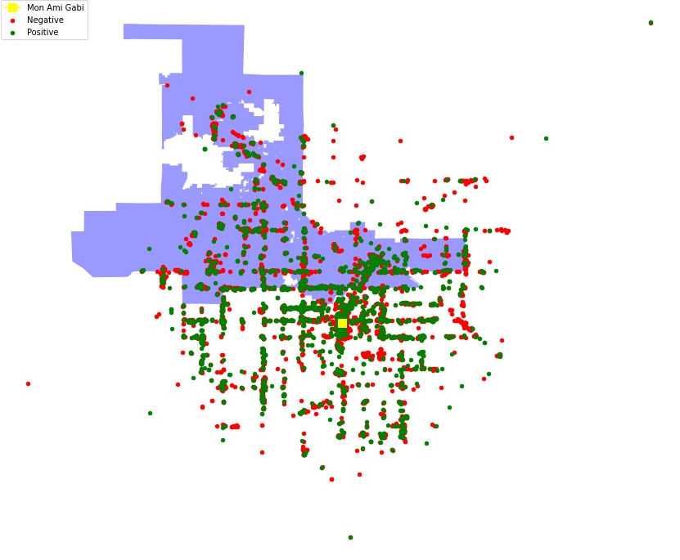
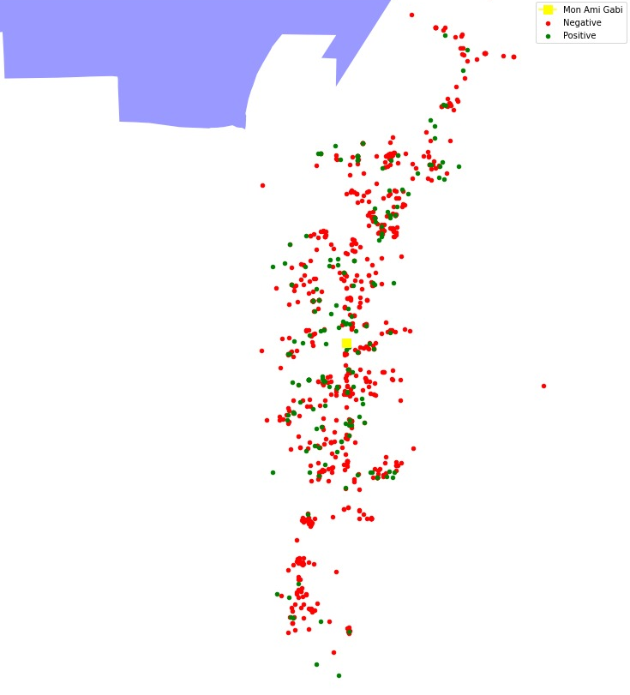

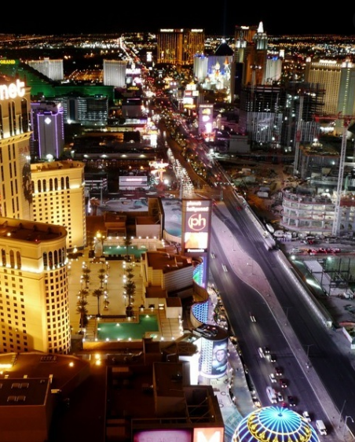
LAS VEGAS BOULEVARD
Data Scalability Challenge
Positive ratings (Total): 66,48%
Positive ratings (Las Vegas Blvd): 62,26%
Notes:
ERIKA

Slide 11
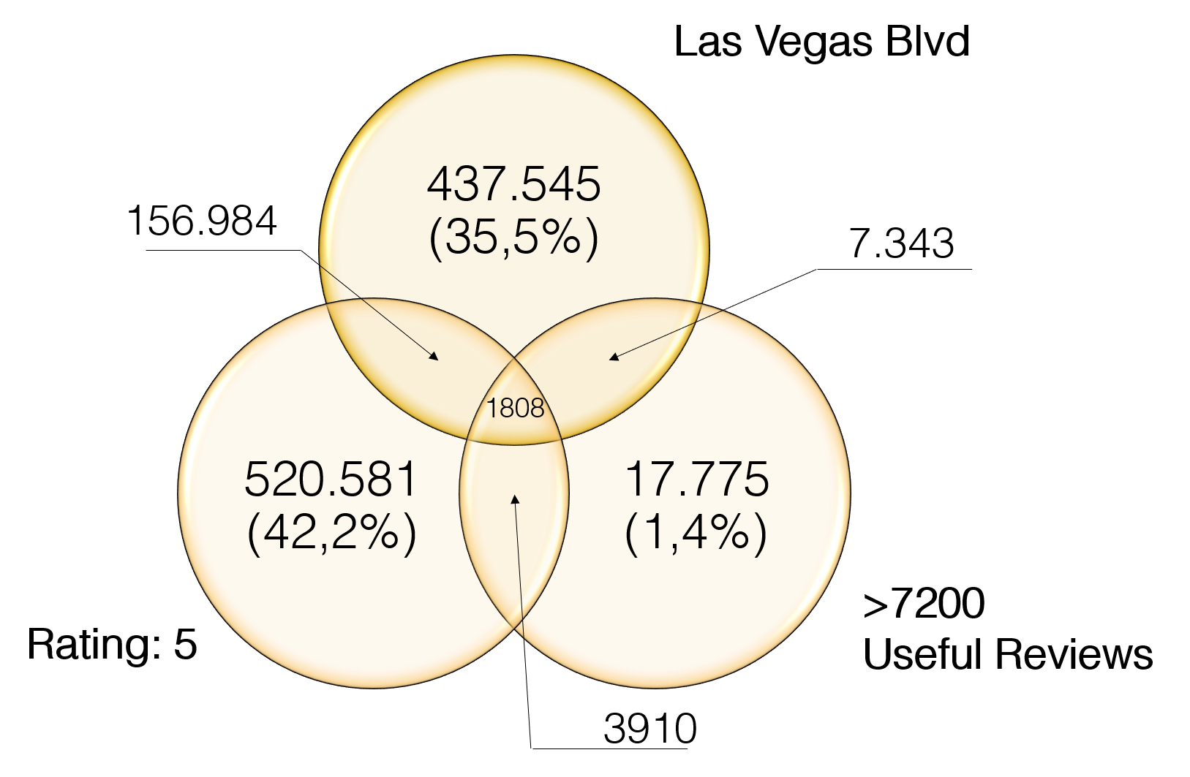
FIND PRINCIPAL TARGETS
1808 reviews
by
15 “Influencers”
from
a total of
1.234.155 reviews in the
complete database
Notes:
ERIKA
Par exemple, un des groupes qu’on a analysé
Influencer clients
All reviews of our restaurant
Recurrent clients of our restaurant

Slide 12
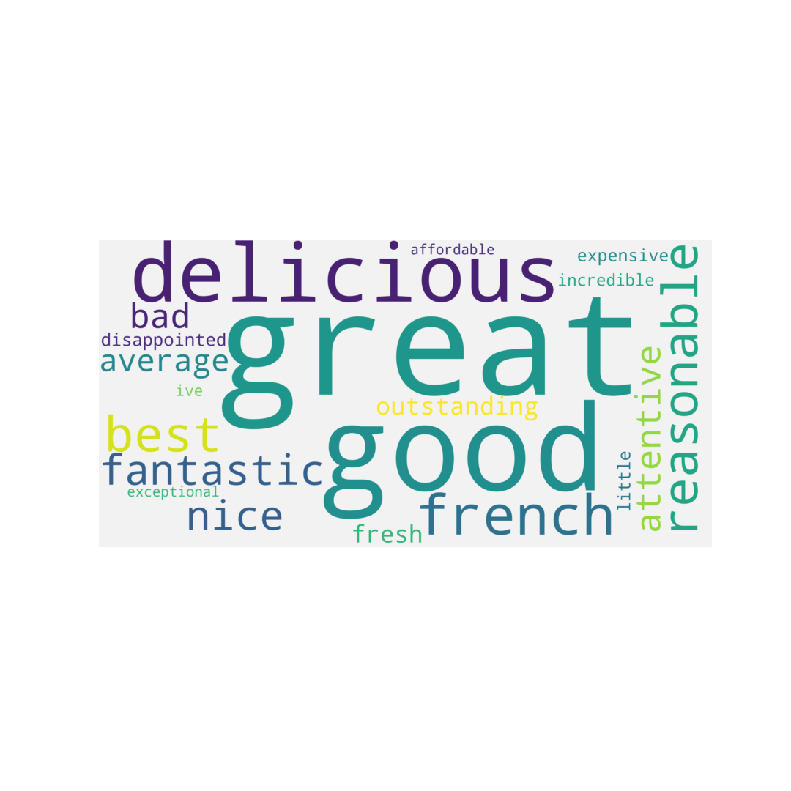
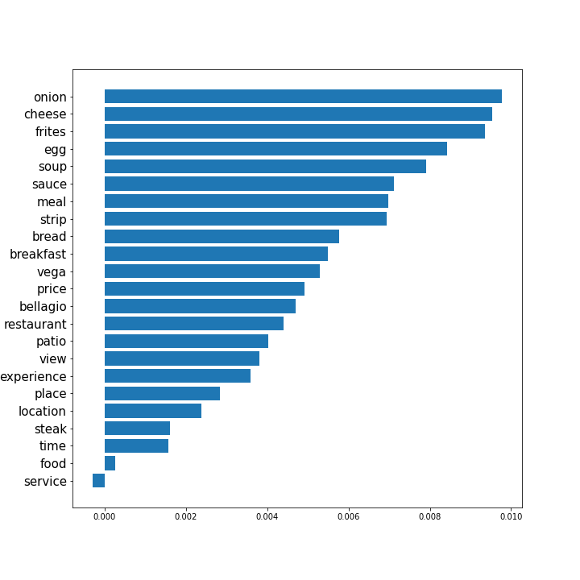
NLP PIPELINE
“Hard to beat this location for table side entertainment..."
1. SETUP
2. IDENTIFICATION WITH LIME
5. DISPLAY
“Hard to beat this location for table side entertainment…”
“Hard to beat this location for table side entertainment…”
“Hard to beat this location for table side entertainment…”
Illustrated
insights
3. SELECTION
4. PROCESSING WITH NLTK TAGGING
Hard
table
entertainment
location
Nouns:{entertainment,location,table}
Adjectives: {Hard}
Notes:
PEDRO
Preparação:
Load pipeline model
Load data cleaned
Extrair review a analisar com base no market analysis (e todas do nosso)
Identificação most important features:
Lime (não testamos outros)
Filtragem
Parâmetros: qtde most important features, qtde surronding words (para saber com o que o adjetivo combina), threshold score (se é positivo ou negativo, não foi usado)
Frequência de aparição do pair [important_feature, surronding_word]
Organização (processamento):
4.1) Separação using grammar class:
Uso de nltk pos_tag para pegar o tipo da palavra
Guardamos adj: substantivos (pq maioria dos important features são adjetivos)
4.2) Inversão:
Substantivos : adjetivos e contagem de qtas vezes adjetivo foi mencionado (mesmo que tenha reviews negativas, temos que saber se aquilo é uma opinião geral dos clientes)
Apresentação
Big words para ver a opinião geral dos clientes

Slide 13
CUSTOMER OPINION ABOUT FOOD
Stand out in Mon Ami Gabi

Slide 14
INSIGHTS FROM DATA
Customers like most in Mon Ami Gabi:

Slide 15
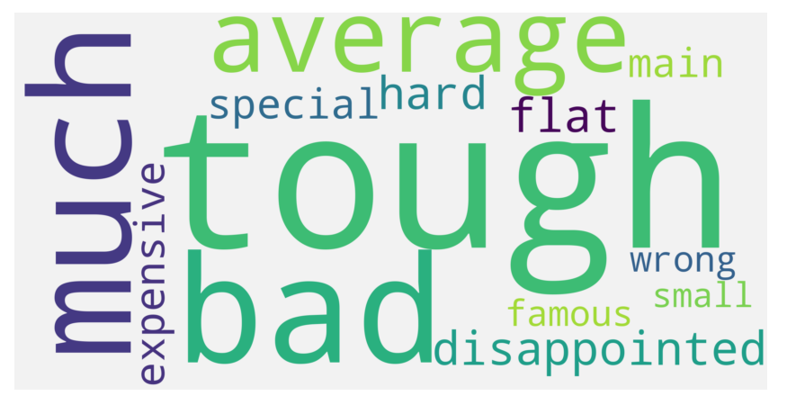
INSIGHTS FROM DATA
Notes:
Why steak is not positive

Slide 16


RECOMMENDATIONS
Marketing
Influencers
Retain Customers
Digital Marketing:
→ table with a view to the patio and water fountain
→ special attention to service
Invite influencers:
→ to breakfast: mention our fresh bread;
→ to lunch or dinner: mention steak (improve our steak!);
→ Create a Menu with onion soup and steak

Slide 17
FUTURE ALTERNATIVES
Further explore the database
Improve our NLP classifier
Try Shap explicability method
Implement topic extraction
Improve computational infrastructure

Slide 18

TEAM TWO
THANKS
Does anyone have any questions?
“Slackathon” 2020
powered by slidesgo

